Slide 1
SHORT STORIES
& The 7 Main Elements

Slide 2
What is a Short Story??
A work of prose fiction shorter than short novel; more restricted in characters & situations.
A short story is usually concerned with not more than a few effects, problems and themes.
It emphasizes human nature and human values.
Time and Characters are limited but the place is not.

Slide 3
What is a Short Story??
Unlike the novel, the characters are not fully developed.
No character analysis.
Generally, a single aspect of character’s personality undergoes a change and/or is revealed as a result of some incident, confrontation or conflict.

Slide 4
Common Features
May be Didactic (teaches a lesson) or read just for pleasure.
Because of the limited length, there are generally no detailed descriptions of a character’s background in a short story.
Only a single unified incident is mentioned.

Slide 5
Short Story’s Origin
Some earlier types of literature, such as myth, legend, fairy tale, fable, essay and character study may be said to be the FOREFATHERS of the short story.
Chaucer’s Canterbury Tales (a collection of stories written at the end of the 14th century) and Boccaccio’s Decameron (a collection of 100 stories written in 1350) are the two earlies examples.

Slide 6

Basic Elements of Fiction
Setting
Characters
Emotion
Plot (Climax, Resolution)
Conflict
Theme
Symbolism

Slide 7
1) SETTING
Time and place are where the action occurs
Details that describe:
  Furniture
  Scenery
  Customs
  Transportation
  Clothing
  Dialects
  Weather
  Time of day
  Time of year

Slide 8
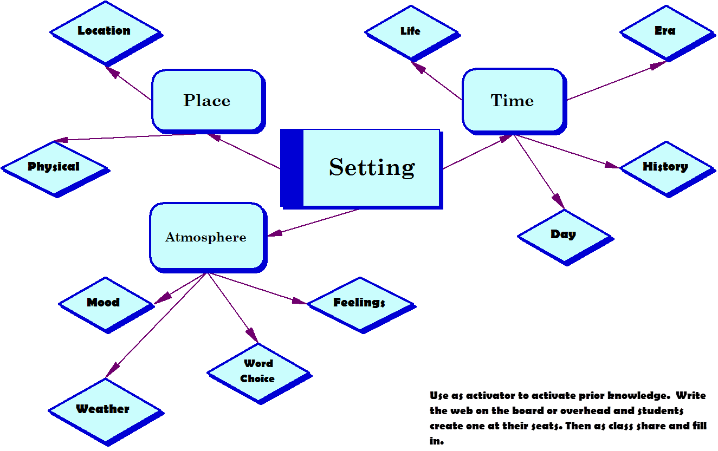
Elements of Setting

Slide 9
Function of Setting
To create a mood or atmosphere
To show a reader a different way of life
To make action seem more real
To be the source of conflict or struggle
To symbolize an idea

Slide 10
2) CHARACTERS
Character creation is more complex than creating a plot from the action. From the words of the character; we can understand and define him/her
A character must be the one according to the community so difficult because infinite variety of human personality.

Slide 11
THREE important qualities for good characterization.
Consistency : The personality should not change unless there is a reason for it (sometimes he may be an inconsistent one as well)
Plausibility: The lifelines of the character.The reader should accept the character as a human being. People from everyday life.
Motivation: The cause for the character to act. Necessary for the characters & also for the readers.

Slide 12
Characters are GENERALLY dramatized, not described.
Ways of Dramatizing Characters:
Writer “paints a picture” of the physical appearance of the character. (Possessions, physical description, immediate surroundings are factors)
Their speech and dialogues may help us
Opinions of others in the story may give an idea about the character
Giving extra information about the characters’ acts attitudes
The writer goes directly into the mind of the character & explains the inner thoughts of him/her

Slide 13
Characterization
A writer reveals what a character is like and how the character changes throughout the story.
Two primary methods of characterization:
  Direct - writer tells what the character is like
  Indirect - writer shows what a character is like by describing what the character looks like, by telling what the character says and does, and by what other characters say about and do in response to the character.

Slide 14
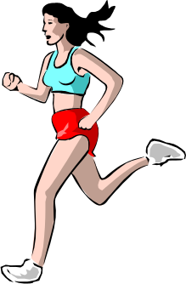
Direct Characterization
…And I don’t play the dozens or believe in standing around with somebody in my face doing a lot of talking. I much rather just knock you down and take my chances even if I’m a little girl with skinny arms and a squeaky voice, which is how I got the name Squeaky.
From “Raymond’s Run” by T. Bambara

Slide 15
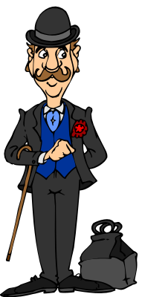
Indirect Characterization
The old man bowed to all of us in the room. Then he removed his hat and gloves, slowly and carefully. Chaplin once did that in a picture, in a bank--he was the janitor.
From “Gentleman of Rio en Medio” by J. Sedillo

Slide 16
Types of Characters
ROUND CHARACTER: is a fully developed character.
FLAT CHARACTERS: CARDBOARD characters, also called one dimensional characters.
STOCK (LITERARY) CHARACTER: If the reader can imagine the flat characters’ actions beforehand, they are called as stock characters.
  Stock characters are used for comic & satirical effects.
  They are generally exaggerated.

Slide 17
Types of Characters
Characters can also be categorized by their role in the story
  Major characters:
    Protagonist
    Antagonist
    Round Characters
  Minor characters:
    Flat characters
    Stock (literary) characters

Slide 18
Changes in Characters
DYNAMIC CHARACTER: There should be a (positive) change in the character; should not END as he started.
  A change in the behaviours, opinions, attitudes is necessary.
  Protagonists are the most dynamic characters
STATIC CHARACTER: If the character remains the same throughout the story he is called as STATIC CHARACTER.

Slide 19
3) EMOTION
Fiction makes us understand & feel.
So emotion is important but not only the emotions of the characters but the readers’ emotion as well.
Non-fictional works like biographies, travel literatures, articles and essays (any prose work that is not fiction) makes us only understand, not FEEL.

Slide 20
How are the emotions conveyed?
Not told directly to the reader.
We learn about them through the actions.
Namely; in an indirect way, in connection with the emotions the tone and the mood of the story are also given.

Slide 21
Elements of Emotion:
There are TWO basic elements
  Tone: The way the writer writes the story. Namely his attitudes towards his characters & events and towards the subject matter determines the tone of the story.
  Mood: The general total atmosphere of the story. Mood is created through the emotions.

Slide 22
Ways of Creating Emotion
By the representation of a single scene that will create lots of emotion.
By the construction of a longer situation.
By mentioning the same theme over and over again (by the repetition of the same theme)
By bringing back the memories, long forgotten events or past experiences.
By creating similar incidents (between past & present) especially using descriptions of sensation.
    These make the reader reflect on their own past

Slide 23
Devices for Establishing the Mood
Dramatic Irony
  What is done and said may not be same with the actual fact or reality.
Suspense
  What will be the next move?
  Thinking about an event in the story: Will he do it or not? (out of a dramatic irony the reader might find himself in suspense)
Sympathy
  Intellectually you understand and admire the character.
  Namely, you understand why he is doing this or that or why he speaks in that way.

Slide 24
Devices for Establishing the Mood
Empathy
  You feel so much for the character that you feel the same things with him.
Restraint
  Element of controlling, because too much of everything is negative.
    Not too much
    Not too little

Slide 25
4) PLOT
The chain of events and incidents that takes place in a short story.
  Overt plot : not secret, open; one incident follows the other chronologically
  Covert plot: not open; some incidents are implied or told indirectly by means of flashbacks & narrative projections in order to break through the monotony.

Slide 26
Parts of a Plot
All plots, from movies to TV shows to literature follow a similar structure:
Inciting incident – event that gives rise to conflict (opening situation)
Development - events that occur as result of central conflict (rising action)
Climax - highest point of interest or suspense of story
Resolution - when conflict ends
Denouement - when characters go back to their life before the conflict

Slide 27
Diagram of Plot
Climax
Resolution
Development/
Rising Action
Introduction
Denouement
Inciting incident/
Opening situation

Slide 28
Plot: The Essence
Essential to reveal the characters and the story (but not everything!!)
  Foreshadowing: may be a hint about what will follow or what will happen next about the characters, the setting or the general atmosphere of the story.
  Precipitating incident: something minor happens at the beginning of the story that accelerates the events in the story.
  In Medias Res : where the plot starts in the middle.

Slide 29
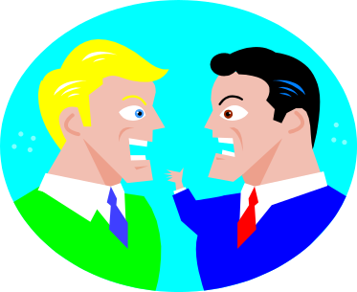
5) CONFLICT
Conflict is a struggle between opposing forces
Every plot must contain some kind of conflict
Stories can have more than one conflict
Conflicts can be external or internal
  External conflict - outside force may be person, group, animal, nature, or a nonhuman obstacle
  Internal conflict - takes place in a character’s mind

Slide 30
6) THEME
The central unifying element of the story
It is the total summary of all the things that take place in the story.
May be stated directly or implied
Interpretation uncovers the theme
It is the feeling and the idea that the story gives us or awakens in our minds and hearts

Slide 31
Theme: Everything relates
The theme cannot be defined in one word or with one simple sentence.
The theme must be expressed in a well constructed sentence. It should express a general idea or a life philosophy.
For example: One must make time to break away the routine daily life to communicate with the other members of the society.

Slide 32
7) SYMBOLISM
A symbol is something such as an object, picture, written word, sound, or particular mark that represents something else by association, resemblance, or convention.
A symbol can be anything ( an item, an object and even a name) that stands for the place of another thing or anything that is used to explain especially abstract ideas meanings better.
All language consists of symbols. The word "cat" is not a cat, but represents the idea of a cat.

Slide 33
Kinds of Symbols
Original Symbols : Arise from the total structure of the story, a new created symbol, you can find it in no other fiction. It is the creation of the writer used for the first time.
Conventional Symbols: Don’t come out of the story naturally, but have been used before by some others and become known by the readers.

