Slide 1
Symbolism
&
Allegory

Slide 2

What’s In A Symbol
SYMBOL:
an object that stands for itself and a greater idea;
it creates a direct, meaningful link between…
a specific object, scene, character, or action
(AND)
abstract ideas, values, persons or ways of life

Slide 3
Symbols & Signs
SYMBOL vs SIGN:
A SIGN is different because it is an object that is taken literally
A SYMBOL can be taken both literally and figuratively

Slide 4

Why Symbols?
You may ask why writers don’t just come right out and say what they mean.
Symbols allow writers to suggest layers and layers of meaning-possibilities that a simple, literal statement could never convey.
A symbol is like a pebble cast into a pond: It sends out ever widening ripples of meaning.

Slide 5
Interpreting Symbols
A symbol can have a variety meanings…
1. PERSONAL: a meaning uniquely associated with our experiences
2. CONTEXTUAL: a private meaning created by an author
3. CULTURAL: a meaning uniquely influenced by our current culture
(ex: dogs represent faithfulness in China, but impurity in Indian/South Asian cultures)

Slide 6
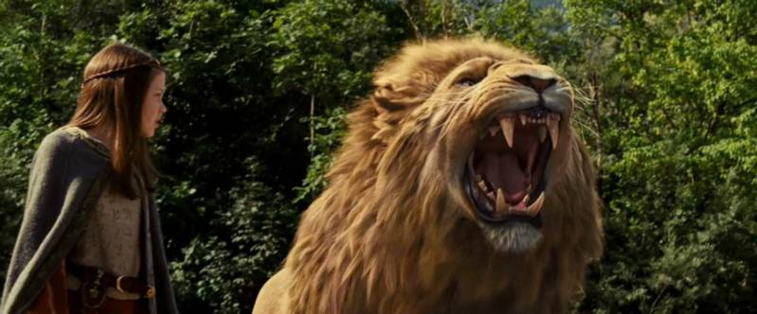
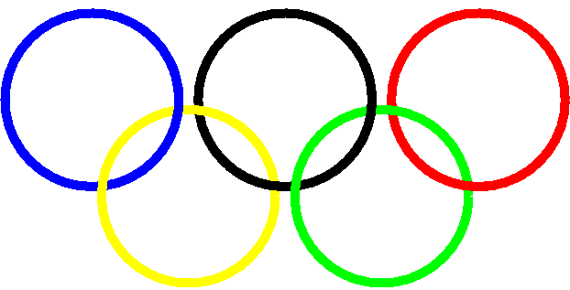
Interpreting Symbols
4. UNIVERSAL: a meaning that is given to a thing by most people and cultures
For Example:
Lions: suggest deity, power
and courage in many cultures
Five linked rings: symbolize the Olympics

Slide 7
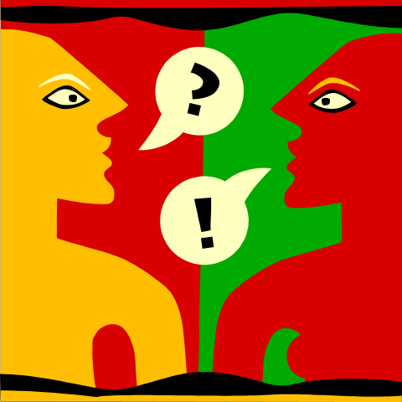
On Interpreting Symbols
A piece of writing will always mean more than a writer intended because of personal associations.
You may not understand all of the contextual symbols an author uses, but might get meaning out of something the author never planned.

Slide 8
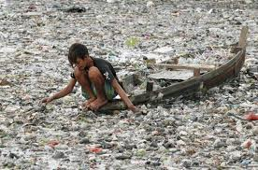
On Interpreting Symbols
We can derive meaning from the symbol itself, but can also make inferences based on how a universal symbol is exhibited or used.
For Example:
Universally, water represents life and purity, so how we might interpret the use of a Polluted river in a story?

Slide 9
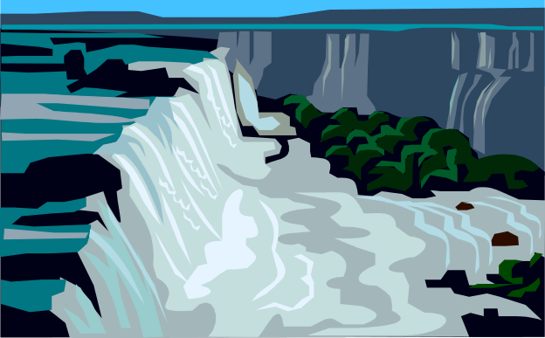






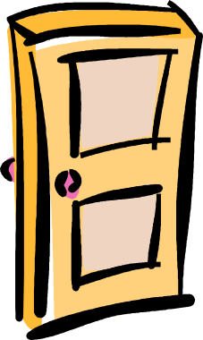



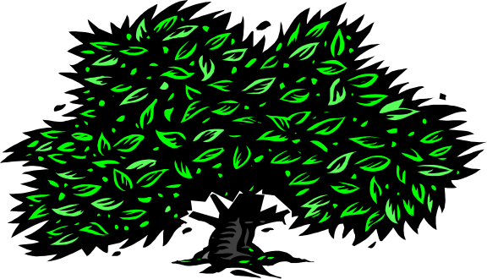


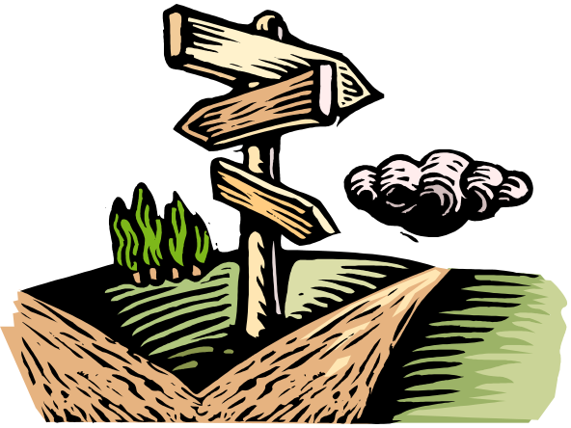

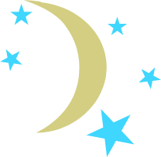




PART 1: How many symbols can you associate with
UNIVERSAL, ABSTRACT ideas or values??
HINT: Don’t limit yourselves to objects, think also about shapes and colors or just parts of a picture

Slide 10
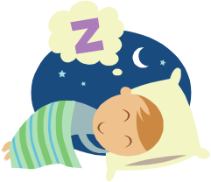


SYMBOLS → SYMBOLISM
SYMBOLISM is simply the use of symbols in art or literature.
PART 2: “I DREAMT A DREAM…”
Dreams are often full of strange events and objects that can be symbolic in nature. In fact, there is tons of literature out there that interprets dreams by putting universal meanings to these unexplainable things.
Your Assignment:
Take as many objects/symbols you discovered in “PART 1” and use them in a narrated dream-sequence. Keep in mind that dreams do not interpret themselves; they are mysterious and abstract.
Your job is to assimilate a dream in all its weirdness; however, it needs to start with a chronological sequence of events that can include your symbols along the way.
It should be at least a half-page long, and no longer than a page. When we’re done, let’s see if we can’t interpret each other’s strange night-time visions…

Slide 11

Allegory
A complete and self-contained narrative that can also be applied to a parallel set of external situations which may be political, moral, religious or philosophical.
In other words, it tells a real story and a symbolic story simultaneously.
Like symbols, allegories can be personal, contextual, cultural and universal.

Slide 12
What’s It Look Like??
You may recognize…
Alice in Wonderland, Lewis Carroll
  Political allegory: "Going down the rabbit hole" is a way of describing a conscious awakening, suddenly realizing that the world around you is not at all how you thought it was and the things that you have been told are lies.
The Lord of the Rings trilogy, Tolkien
  The Lord of the Rings also appears to address issues specific to the twentieth century, particularly the sense of loss, despair, and alienation that came as a result of the two World Wars. Many have read the trilogy as an allegory of the history of modern Europe, especially the rise of Adolf Hitler and Nazism in Germany.

Slide 13
What’s It Look Like??
The NARNIA series, C.S. Lewis
  Are often considered allegories, although C. S. Lewis himself did not intent them to be. Contained in each of the seven books are allegorical elements which represent many aspects of the Christian faith and religion. Aslan (the lion) is often considered to be the fictional representation of Christ.
The Divine Comedy, Dante
  Each canto (section), and the episodes within, contain many alternative meanings. Dante's allegory, however, is more complex, and, in explaining how to read the poem he outlines other levels of meaning besides the allegory: the historical, the moral, the literal, and the anagogical.

Slide 14
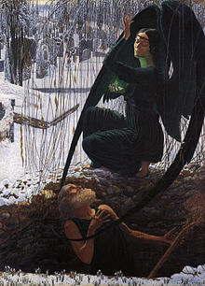
The Bottom Line
Symbolism and Allegory are literary “modes”
They are used to expand the meaning that the author intends to portray.

