Slide 1
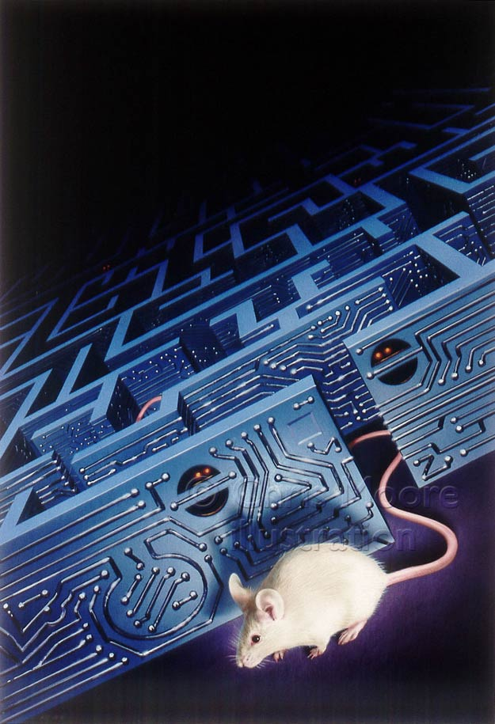
Flowers for Algernon
By Daniel Keyes

Slide 2
Story Vs Video
The two “Charlies” that we meet are two different characters.
This is due to the fact that, in the story, we learn about Charlie through his own diary
In the film, we can literally SEE him and hear him
Is there one way that is easier for you to think about him?

Slide 3
Story Vs Video
ASSIGNMENT:
Think of the two Charlies
Write a paragraph discussing how the Charlies are represented in each of the “stories”
How do they differ?? Are they similar??
What are your thoughts on having a “typical” actor playing someone who is mentally disabled
You should have no less than 150 words!!

Slide 4
Want More??
If this issue (treatment of the mentally and developmentally disabled) interests you, watch “I Am Sam”, with Sean Penn and Michelle Pfeiffer

